Slide 1

New York City Airbnb listing price prediction
Vladimir Andrianov Äriinfotehnoloogia, IABM34_Virumaa
Tallinn University of Technology
25.11.2021

Slide 2
New York City Airbnb listing price prediction
Introduction
Airbnb, Prices
Work environment
Related Works
Predicting the rental value of houses
Dataset
Kaggle
Analysis
Charts, data sorting, correlations, maps
Classification
Methods & Results
Regression
Methods & Results

Slide 3


Introduction
Airbnb
Metrics
Rental prices
Correlations
Price prediction
Work environment
Python
Anaconda
Jupyter Notebook

Slide 4
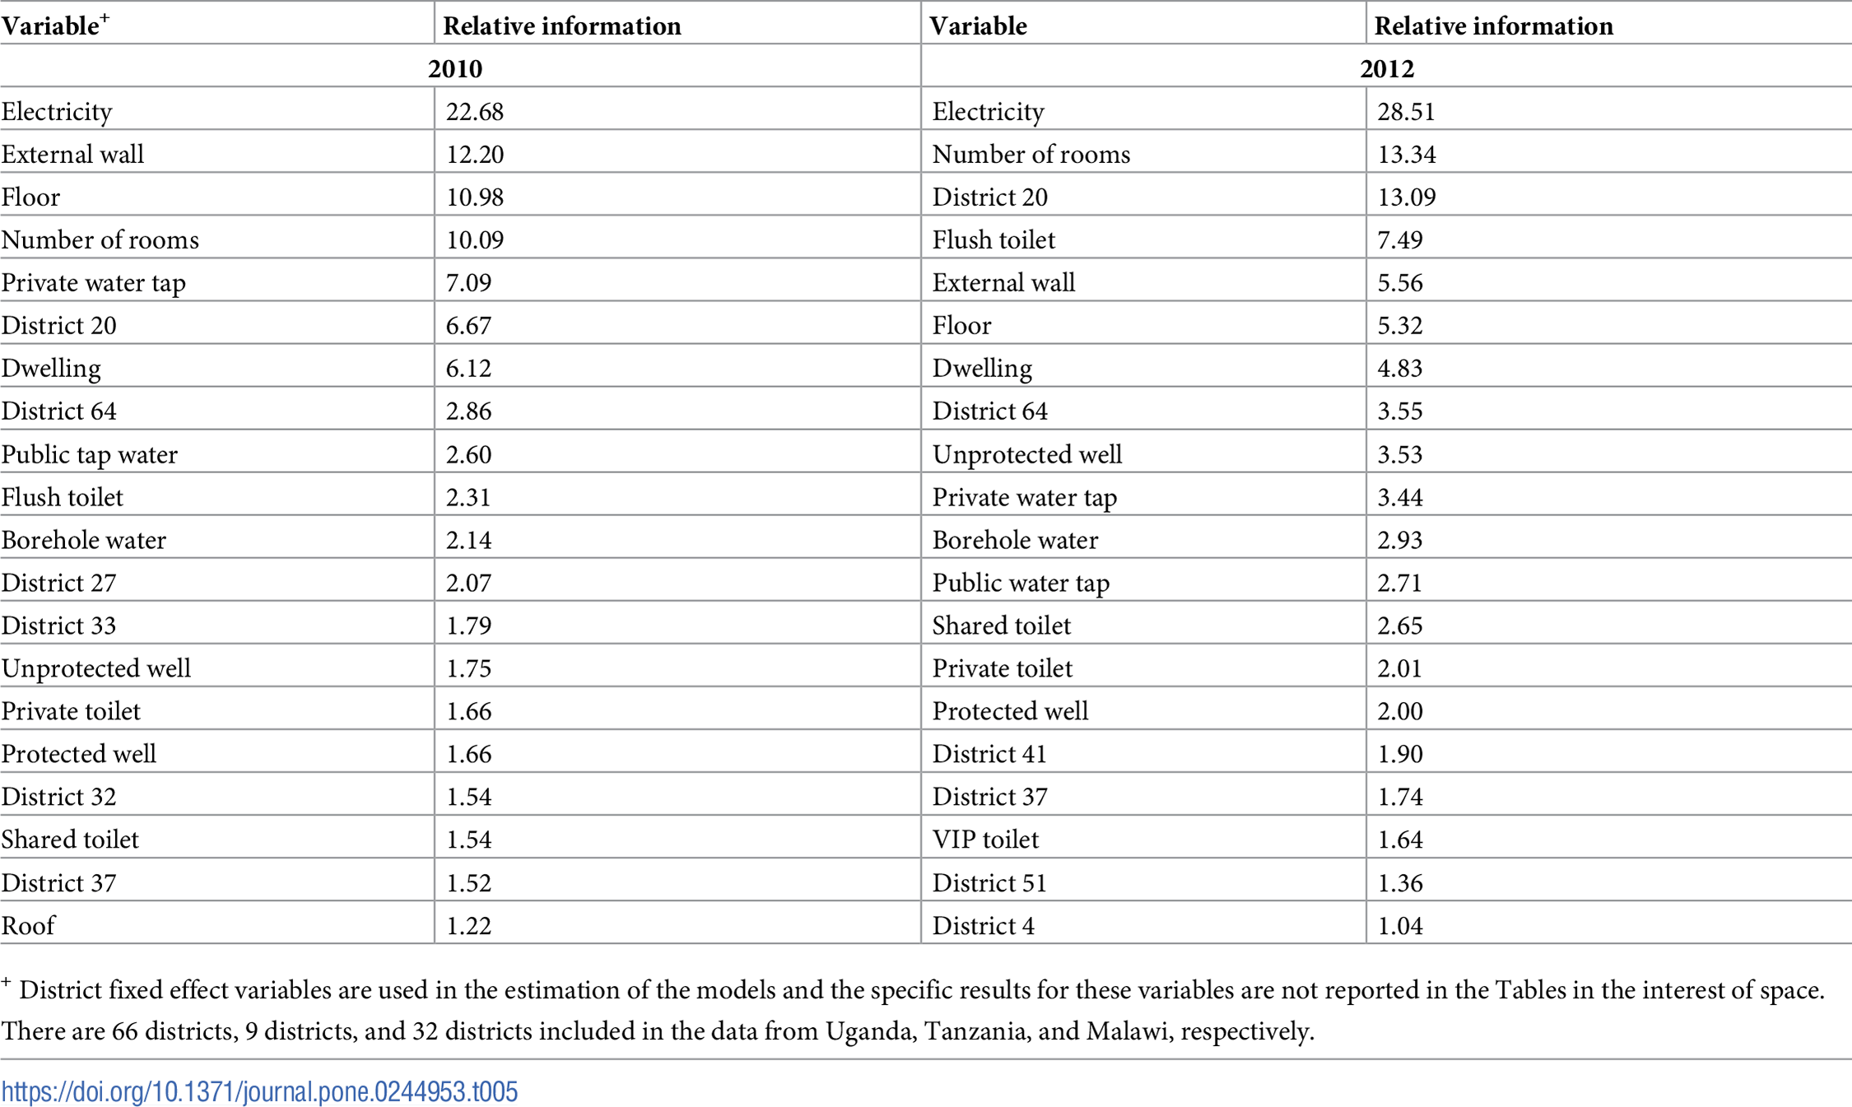
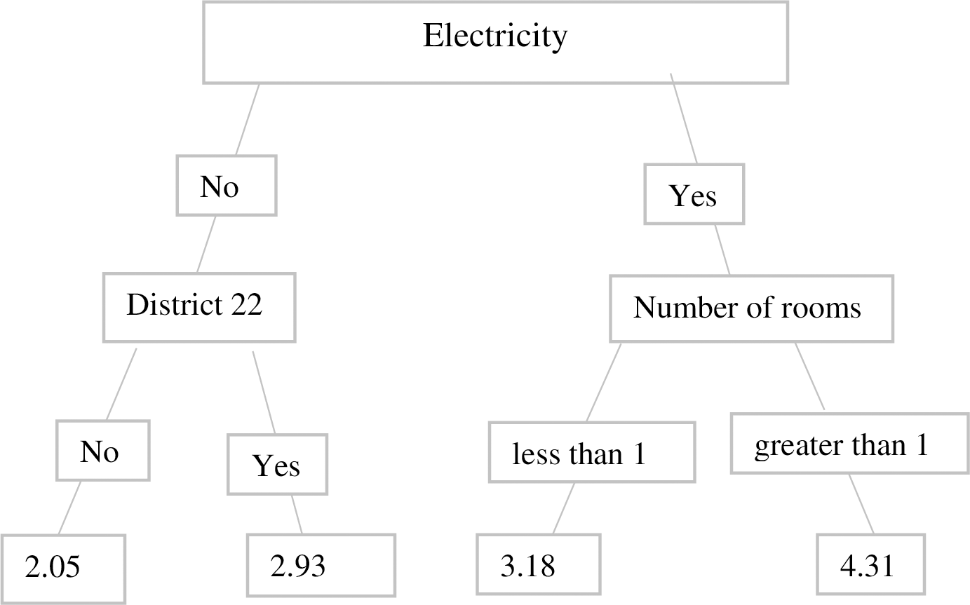
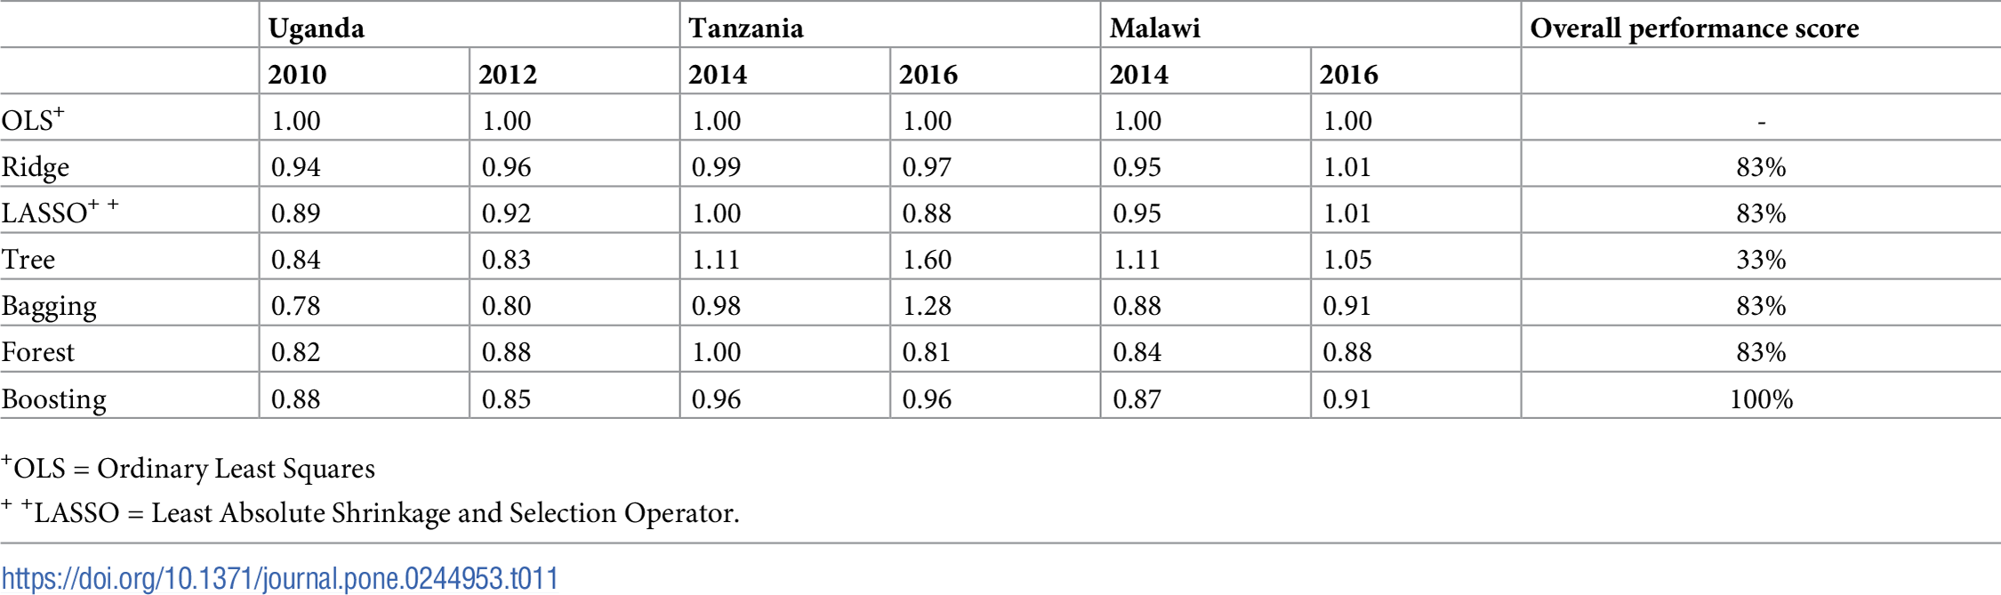
Related works
“Predicting the rental value of houses in household surveys in Tanzania, Uganda and Malawi: Evaluations of hedonic pricing and machine learning approaches“
Rental value prediction

Slide 5

Dataset
Kaggle
Airbnb public data
2019 year
NYC
Usability
10/10
Data dictionary
48895 rows
16 columns

Slide 6
Analysis
Charts
Data distribution
Detecting outliers in the data
Data sorting
Dropping outliers, attributes
Converting categorical data to factors
Correlations
Correlation matrixes
Numbers and factors
Maps
Heat map
Price map & longitude and latitude

Slide 7
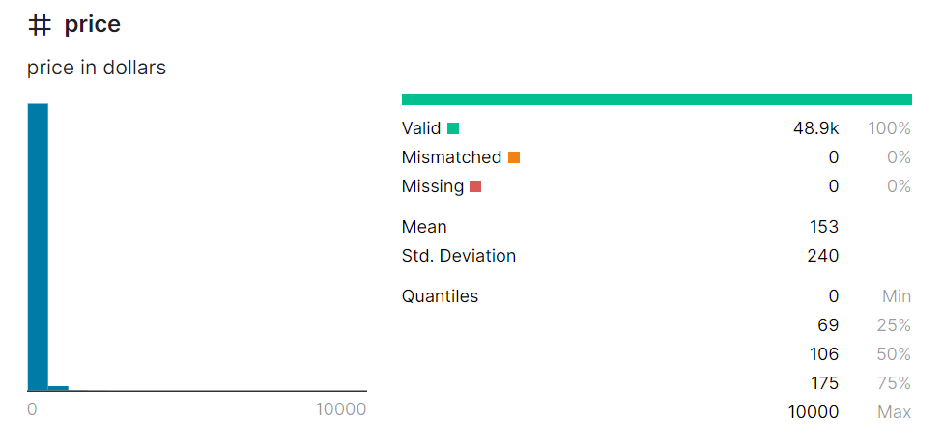
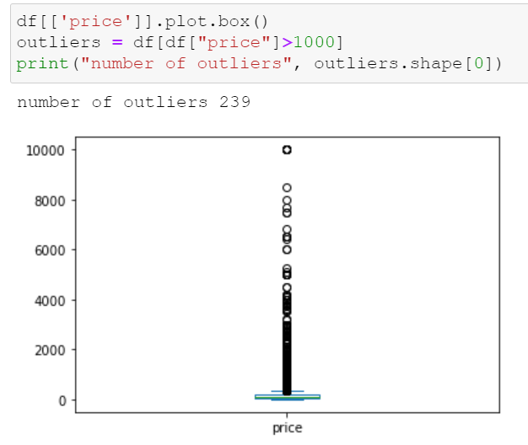
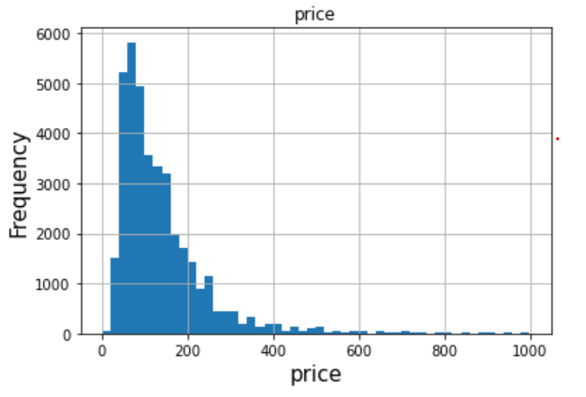
Charts
Charts
Data distribution
Detecting outliers in the data

Slide 8
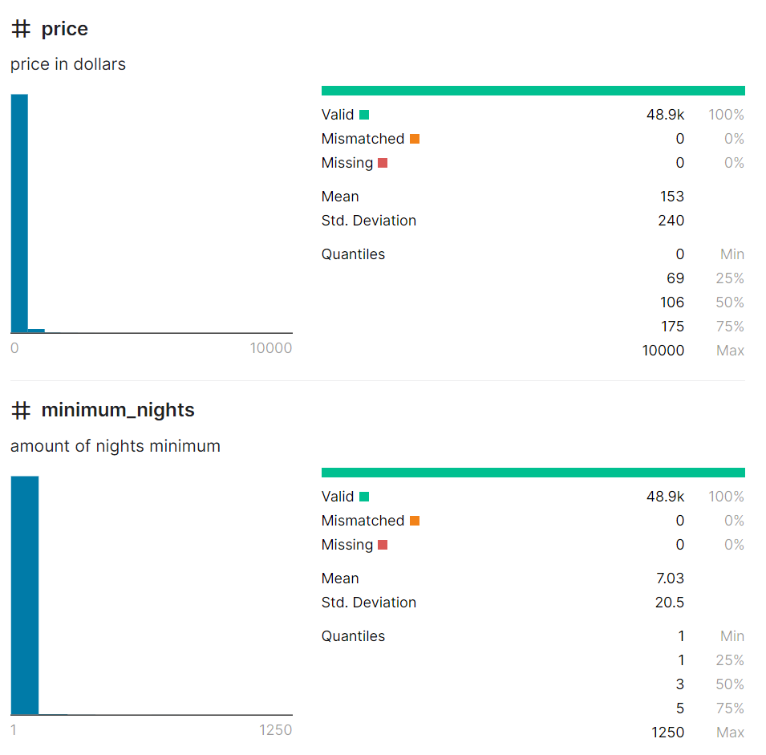
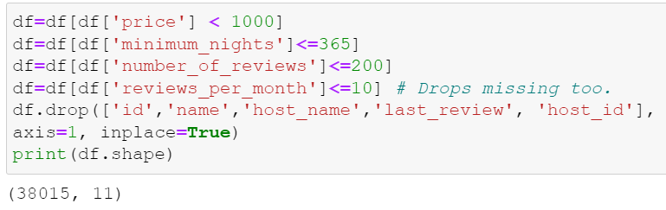
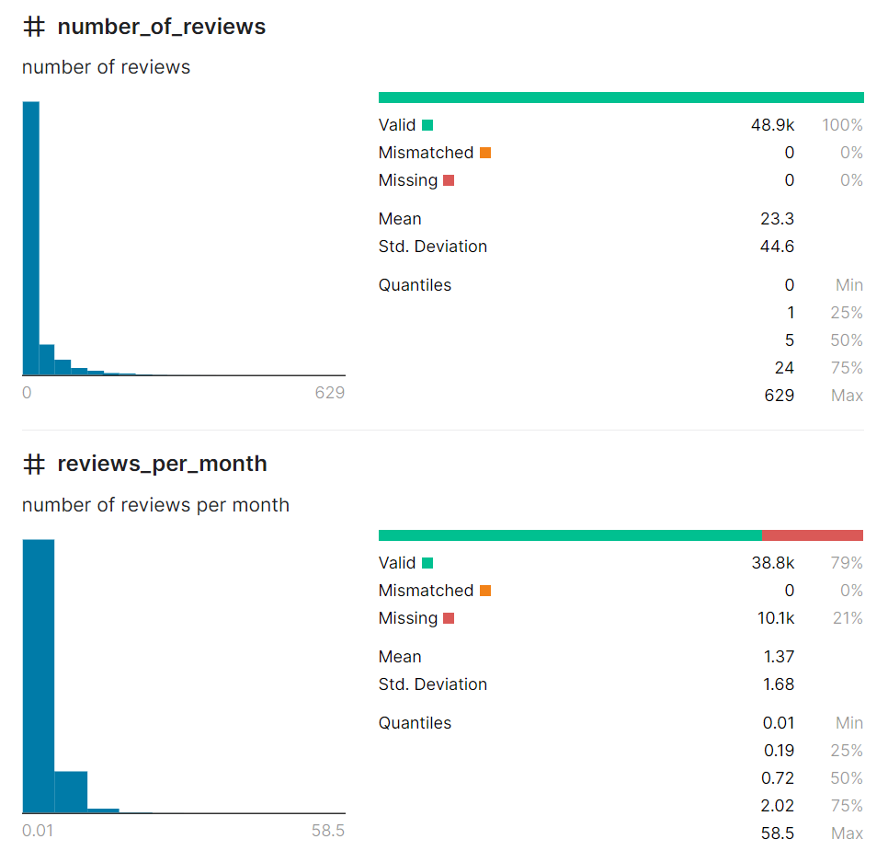
Data sorting
Data sorting
Dropping outliers, attributes
Converting categorical data to factors

Slide 9
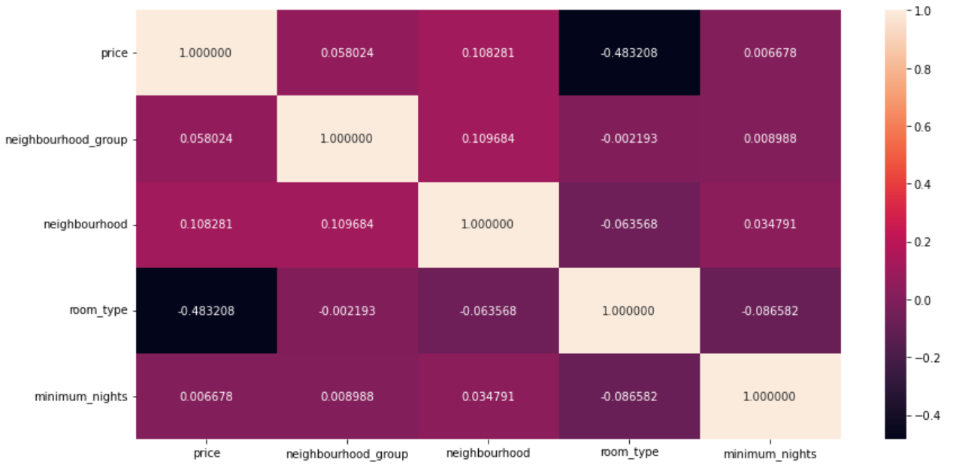
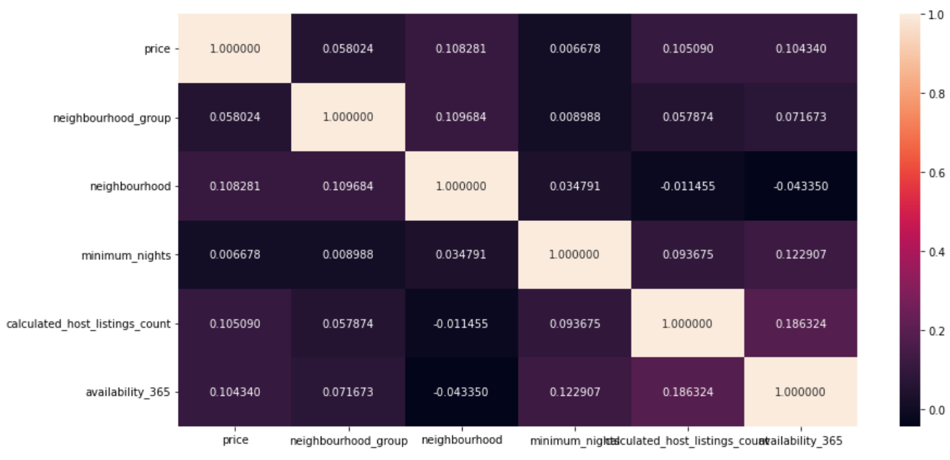
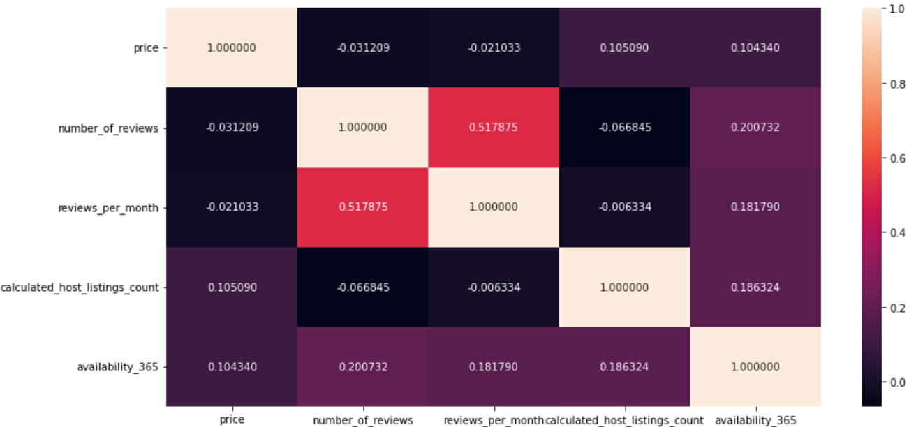
Correlations
Correlations
Correlation matrixes
Numbers and factors

Slide 10
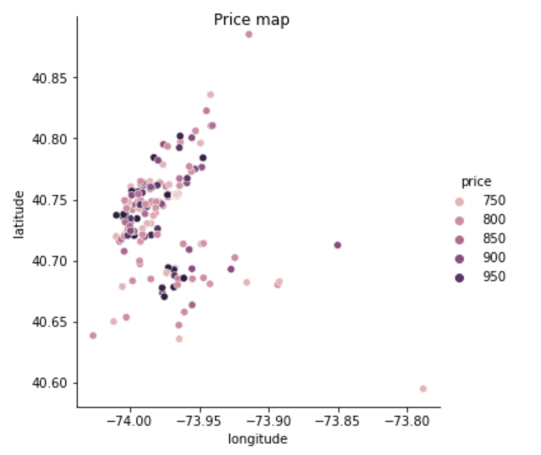
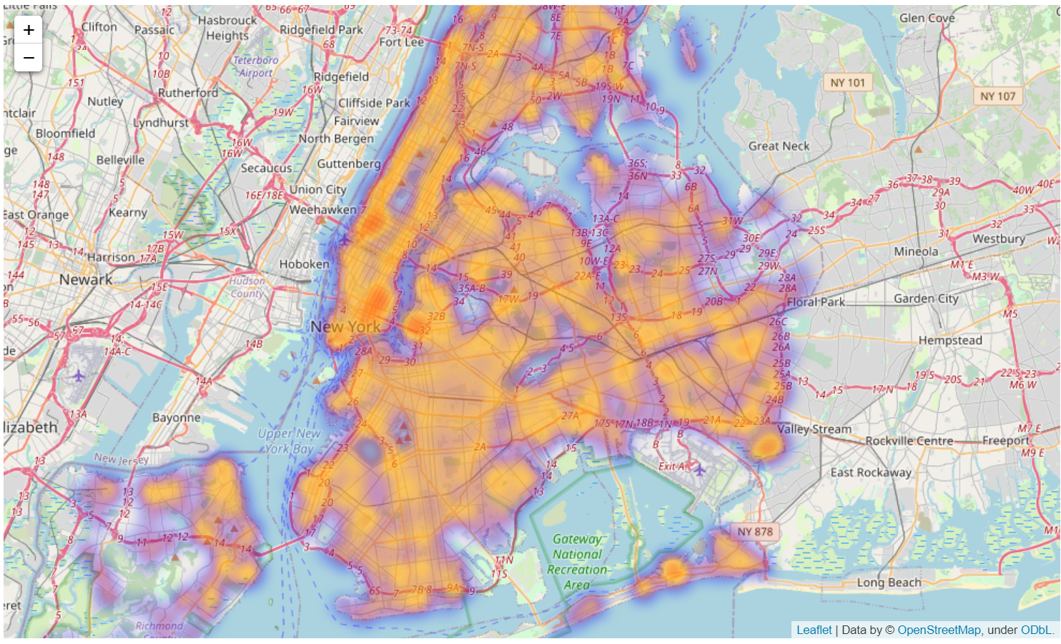
Maps
Heat map
Price map & longitude and latitude (0.2:blue, 0.4: purple, 0.6: orange, 1.0: red)

Slide 11
Classification
Theory “bigger apartment is and the closer it to the center, the more expensive it is, and cheapest rooms are shared”
Room type classification based on “neighbourhood_group” and “price”
Methods
Naive Bayes
Support Vector Machine (SVM)
Decision Tree

Slide 12
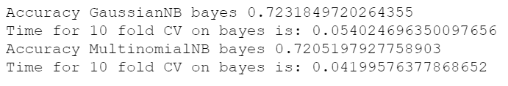
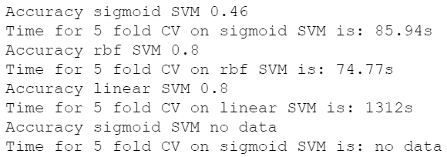
Naive Bayes, Support Vector Machine (SVM)
Naive bayes is faster than SVM, SVM “sigmoid” ran out of time (>2 hours)
Well-picked SVM is more accurate

Slide 13
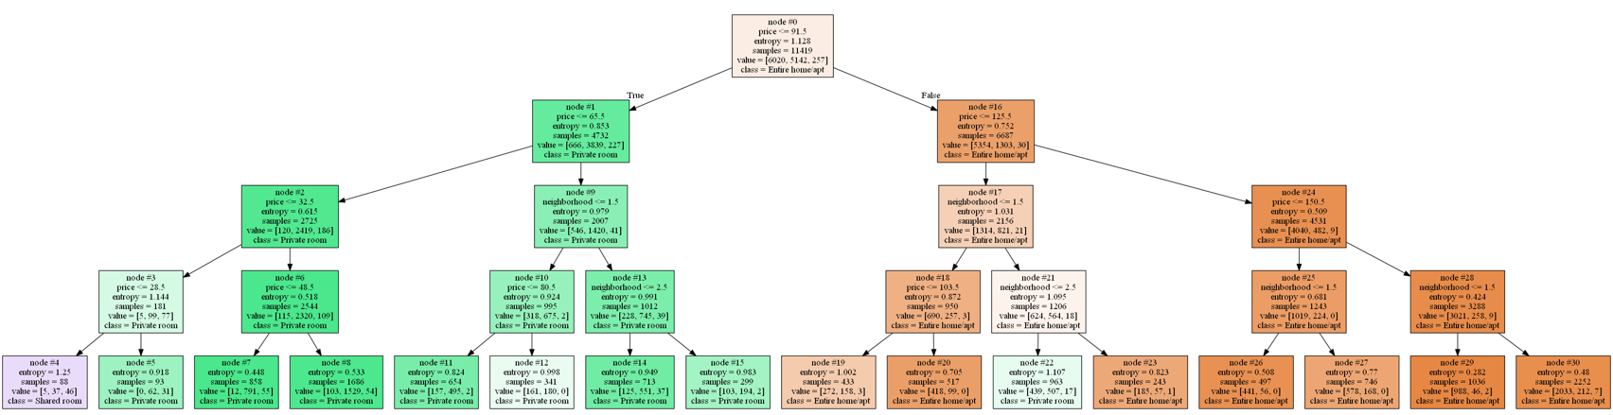
Decision Tree
Min. requirements: 31 nodes (2n−1=31, n=5)
Depth = 4
Min_samples_leaf = 2

Slide 14
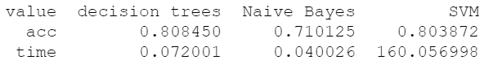
Results
Decision tree
Most accurate
Mid-performance
SVM
Accurate as decision tree
Slowest
Naive Bayes
Inaccurate but fastest

Slide 15
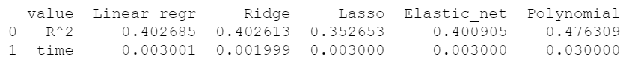
Regression
Regression
Linear regression
Reducing range
Ridge regression
Lasso regression
Elastic-net regression
Polynomial regression

Slide 16
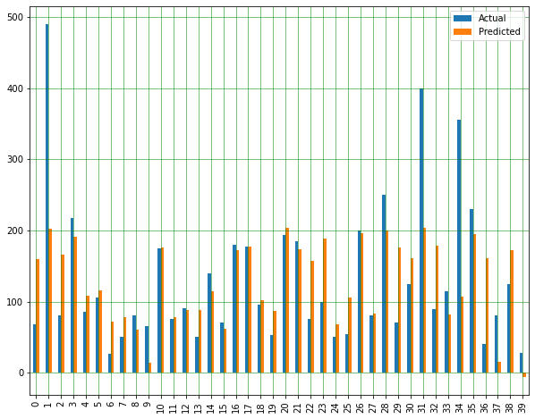
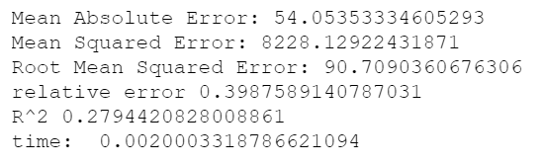
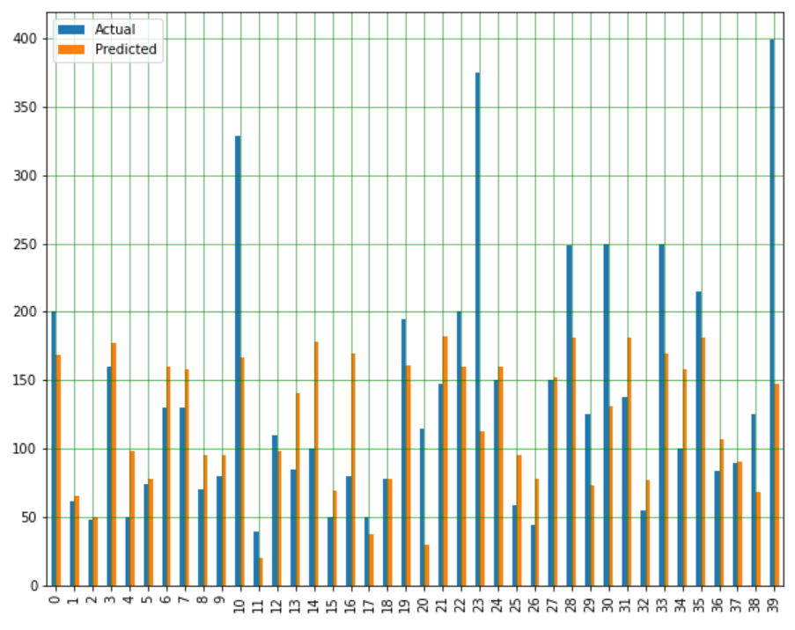
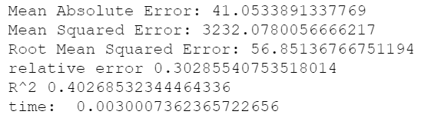
Linear regression
Full range (mean 153, >1000 dropped)
Drop outliers “<400”

Slide 17
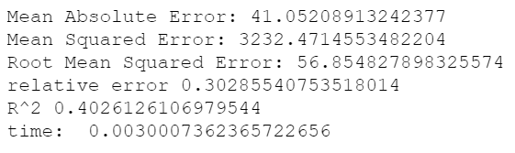
Ridge regression
Helps in case of multicollinearity
Not the case with current data
Similar to linear regression results

Slide 18
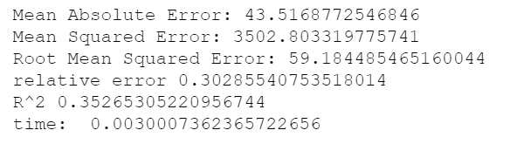
lasso regression
Less accurate than linear and ridge regressions

Slide 19
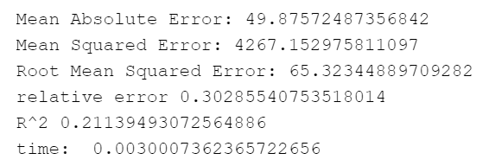
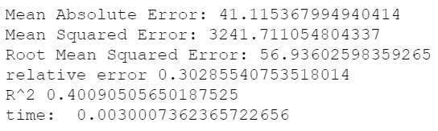
Elastic-net regression
Alpha:
1
Changed from 1 to 0.001

Slide 20
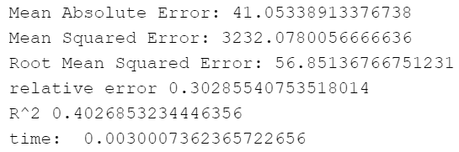
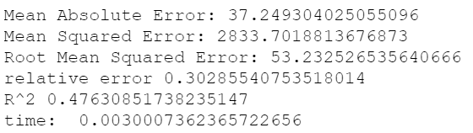
Polynomial regression
Helps in case of non-linear relationship
Helps with current data
Best result (default 1 degree and 5)

Slide 21
Results
Linear: average accuracy, average speed
Ridge: average accuracy, best speed
Lasso: worst accuracy, average speed
Elastic-net: average accuracy, average speed
Polynomial: best accuracy, average speed

Slide 22

Thank you !

